Slide 1

webhook in MS Teams
By kunj sangani

Slide 2





Kunj SANGANI
I am SharePoint and M365 Enthusiast with 6 years of experience and counting
I love to learn and share my learnings
I love to collaborate with all M365 enthusiast
Please connect with me on any of the below platforms
@sanganikunj
kunj-sangani
kunj.sangani
kunj-sangani

Slide 3
Agenda
What is webhook
Why is It helpful
How is webhook secured
How should webhook respond
Incoming webhook in MS Teams
Outgoing webhook in MS Teams
Questions and Answers

Slide 4
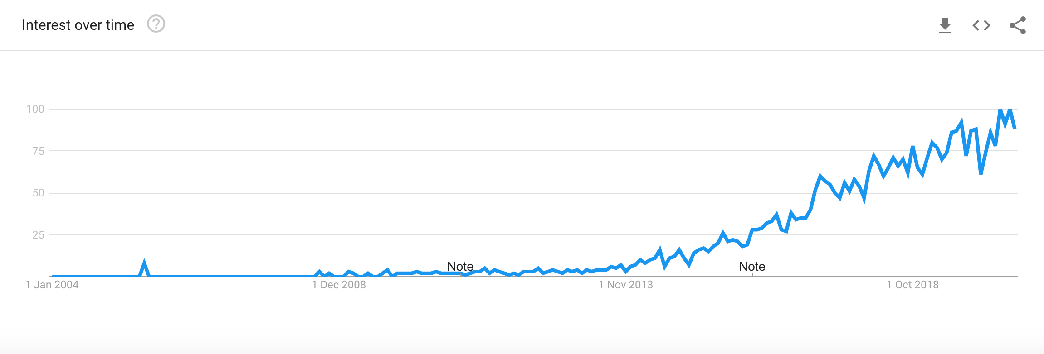
What IS webhook
Webhook is one of the way that apps can send automated messages or information to other apps.
There are two mechanism our apps can communicate with each other to share information
Pull
Push
Notes:
Polling is like knocking on your friend’s door and asking if they have any sugar.
Webhooks are like someone tossing a bag of sugar at your house whenever they buy some.

Slide 5
Difference Between PUSH and PULL
PULL
Buyer Shop
2pm
4pm
6pm
8pm
PUSH
Buyer Shop
8pm
Here the buyer calls the shop keeper after every 2 hours to check the availability of phone
Here the shopkeeper calls the buyer once the phone is available
Notes:
Polling is like knocking on your friend’s door and asking if they have any sugar.
Webhooks are like someone tossing a bag of sugar at your house whenever they buy some.

Slide 6
WhY IS IT HELPFUL
Webhook is helpful when we would want our application to send data to other application or extend our application on particular events
Webhook provide flexibility for developer to extend on event and write their own code and perform any task as per their need and imagination no restriction
Example of Using Webhook in Github
https://webhook.site/
https://github.com/kunj-sangani/kunj-sangani.github.io
Notes:
Polling is like knocking on your friend’s door and asking if they have any sugar.
Webhooks are like someone tossing a bag of sugar at your house whenever they buy some.

Slide 7
HOW ARE WEBHOOK SECURED
Example of Webhook with payments provider like PayPal , stripe and others
Few of the recommended points to keep webhook secured are as mentioned below
Use HTTPS based endpoints
Use Pre-Shared secret and hash mechanism
Encode the message with some encoding mechanism for extra security
For MS Teams SHA-2 cryptographic hash function to encode with digest size as 256 bits
Notes:
Polling is like knocking on your friend’s door and asking if they have any sugar.
Webhooks are like someone tossing a bag of sugar at your house whenever they buy some.

Slide 8
HOW SHOULD WEBHOOK RESPOND
Webhook should respond as soon as possible without waiting for the operation to complete a respond should be provided indicating the request has been received
Note: MS Teams wait for 5 seconds before confirming the request timeout
Notes:
Polling is like knocking on your friend’s door and asking if they have any sugar.
Webhooks are like someone tossing a bag of sugar at your house whenever they buy some.

Slide 9
Incoming webhook in MS Teams
Incoming webhook are special type of Connector in Teams that provide a simple way for an external app to share content in team channels and are often used as tracking and notification tools.
Teams provides a unique URL to which you send a JSON payload with the message that you want to POST, typically in a card format.
Incoming webhook is scoped and configured at the channel level
https://docs.microsoft.com/en-us/adaptive-cards/
https://adaptivecards.io/explorer/AdaptiveCard.html

Slide 10
DEMO

Slide 11
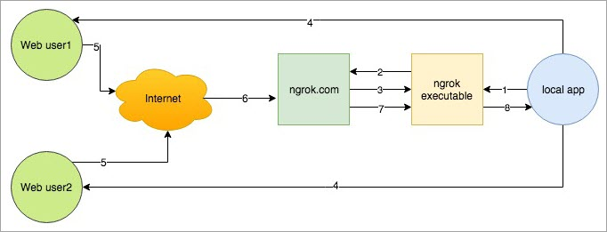
WHAT iS NGROK
Ngrok is a useful utility to create secure tunnels to locally hosted applications using a reverse proxy. It is a utility to expose any locally hosted application over the web.
In simple terms, it provides a publicly accessible web URL to any locally hosted application

Slide 12
Outgoing webhook in MS Teams
In Teams, outgoing webhook provide a simple way to allow users to send messages to your web service without having to go through the full process of creating bots via the Microsoft Bot Framework.
Outgoing webhook post data from Teams to any chosen service capable of accepting a JSON payload. Once an outgoing webhook is added to a team, it acts like bot, listening in channels for messages using @mention, sending notifications to external web services, and responding with rich messages that can include cards and images.
Outgoing Webhook are scoped at the team level

Slide 13
DEMO

Slide 14
References
https://docs.microsoft.com/en-us/microsoftteams/platform/webhooks-and-connectors/what-are-webhooks-and-connectors
https://docs.microsoft.com/en-us/microsoftteams/platform/webhooks-and-connectors/how-to/add-outgoing-webhook
https://docs.microsoft.com/en-us/microsoftteams/platform/webhooks-and-connectors/how-to/add-incoming-webhook
https://www.c-sharpcorner.com/blogs/outgoing-webhook-in-ms-teams
https://www.c-sharpcorner.com/blogs/incoming-webhook-in-ms-teams

